Slide 1
Frequent Questions

Slide 2
Question – will the Thursday calls continue – now that PHE has ended?
Indiana Health Care Association will continue to have weekly calls for our profession. Providing current and relevant topics to keep nursing homes and assisted living facilities up-to-date with information.
IHCA is fortunate to have collaboration with experts such as IDOH, QIO –QSource, Probari, and IDOH Infection Preventionist.

Slide 3
The calls are recorded, and available on demand.
Handouts are available if you miss the calls
https://www.ihca.org/covid-19#section-5/
This link wording is likely to change soon, and I will let you know when it will happen.

Slide 4
Did Survey Documents Change for SNFs ?

Slide 5
Items were added and removed from Entrance Conference Worksheet – SNF
Additions to the Entrance Conference Worksheet
Must provide the Medical Director’s phone number within one hour of entrance
Recommended Actions:
Add this to the survey binder in your facility
Ensure you are using the current Entrance Conference Worksheet – handout today

Slide 6
Items Modified to the Entrance Conference Worksheet
Information provided regarding arbitration agreements
Needed by the end of the first day of survey
41. Provide a list of residents, who are currently residing in the facility that have entered into a binding arbitration agreement on or after 9/16/2019.

Slide 7
Items removed from the Entrance Conference Worksheet
List of resident who are confirmed or are suspected cases of COVID-19.
Staff responsible for overseeing COVID-19 vaccination effort.
Facility mechanism(s) to inform residents, their representatives, and families of confirmed or suspected COVID-19.
Documentation related to COVID-19 testing.
List of residents and their COVID-19 vaccination status.
The staff responsible for notifying all residents, representatives, and families of confirmed or suspected COVID-19 cases in the facility.

Slide 8
Changes to CE pathway – IPC and Immunization
Employee COVID-19 vaccination information reduced
Review of source control were changed to only require surveyors to ensure source control is in accordance with national standards.
Surveyors must ensure facility residents and staff were offered and educated on any potential risks of receiving the COVID-19 vaccination.
Surveyors must ensure visitors were educated of the potential risk, before visiting residents on Transmission Based Precautions (TBP).

Slide 9
Recommended Actions:
Review IPC CE Pathway – the modified one
Understand national standards for testing and source control
Know what education do you provide to residents and/or staff related to risks associated with COVID-19 vaccination.
Be able to show how your facility offered COVID-19 vaccination and educated residents and staff on risks of vaccination.
Be able to show how you educate visitors on risk of visiting residents in Transmission-based precautions.

Slide 10
Many Questions Now what “exactly” are we supposed to do now that the PHE has ended ? Or Has IDOH weighed in on what exactly they want us to do with testing?

Slide 11
COVID-19 Testing Requirements
Nursing homes are required by CMS to follow accepted standards for infection prevention and control – and therefore will be subject to following CDC recommendations under infection control requirements.
Mitigation strategies falls into this same standard.

Slide 12
CDC and testing for COVID-19
PCR Tests – Gold standard – May take up to 3 days
Antigen Tests – Results in 15 to 30 minutes – Positive results are very accurate and reliable – less likely to detect virus than PCR tests, especially when symptoms are not present. A single test cannot rule out infection .
https://www.cdc.gov/coronavirus/2019-ncov/symptoms-testing/testing.html

Slide 13
CDC Testing for COVID-19
FDA recommends – 2 negative Antigen tests for individuals with symptoms or 3 antigen tests for those without symptoms, performed 48 hours apart. Note a single PCR test can be used to confirm an antigen test result.

Slide 14
Key Times to Get Tested for COVID-19
If symptomatic – test immediately
If you are only testing a single time – a PCR test is more reliable negative test result.
If you use an antigen test, a positive result is reliable, but a negative test is not always accurate.
If antigen test is negative, take another antigen test after 48 hours or take a PCR test as soon as you can.

Slide 15
Key Times to Get Tested for COVID-19
Testing can be helpful if you are going to be around someone at higher risk. (testing 1-2 days before the event).
https://www.cdc.gov/coronavirus/2019-ncov/symptoms-testing/testing.html

Slide 16
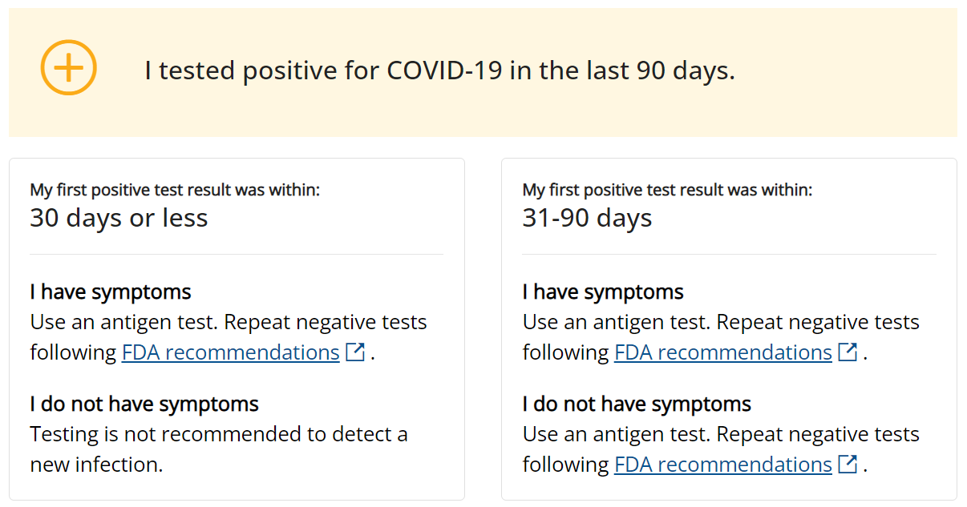

Slide 17
Positive Test
Isolate – TBP
Appropriate Mask
Consider treatment options
Monitor symptoms
Identify close contacts – take appropriate action

Slide 18
Negative Test
A negative result of a test = the virus was not detected
If symptomatic – you might have tested before the virus was detectable.
You may have another viral infection or illness that you need to get tested for.
If you do not have symptoms but were exposed to the virus that causes COVID-19, continue to take precautions.

Slide 19
Exposed
Start steps immediately
Wear a mask – day 0 is the day of last exposure to someone with COVID.
Day 1 is the first full day after exposure
Continue precautions 10 full days
https://www.cdc.gov/coronavirus/2019-ncov/your-health/if-you-were-exposed.html

Slide 20
Exposed continued
Symptomatic – test immediately
Day 6 – test at least 5 full days after exposure – even if symptoms do not develop.
Continue to take precautions through day 10 – wear a mask – high quality one when around others at home and in public.
You can develop COVID-19 up to 10 days after you are exposed.

Slide 21
COVID-19 Provider Vaccine Mandate
Still in effect
Formal and lengthy process to end any rule
Stay tuned

Slide 22
Post PHE – Infection Control for Transmission-Based Precautions

Slide 23
Educate Visitors - prior to a visit
Risk s of visiting a person is on TBP
Precautions necessary when someone in on TBP
Visual alerts to visitors regarding hand hygiene, proper cough etiquette and visiting while sick.
Have Policy and procedures in place regarding face coverings and masks based on recommendations from CDC, state , local health departments and facility circumstances.

Slide 24
Thing you need to know or do
Visitation cannot be limited – visitation is not recommended if a resident is in TBP but cannot be restricted
Hand hygiene – use of alcohol-based hand rub preferred – use it correctly
Visitors need to understand risks of being exposed to a resident in TBP
Understand what PPE is necessary for the precautions used

Slide 25
Resource
Immunize.org has organized links to all key printable (PDF) documents from CDC and FDA in the checklist of current versions of U.S. COVID-19 Vaccination Guidance and clinic support tools.
https://www.immunize.org/covid-19/?gad=1&gclid=Cj0KCQjwjryjBhD0ARIsAMLvnF_T_dKc9BBc-WLiZqln3xRl_DGw0cZ1wmR2witRcaTfMV4ccsEBrSUaAuNKEALw_wcB

Slide 26
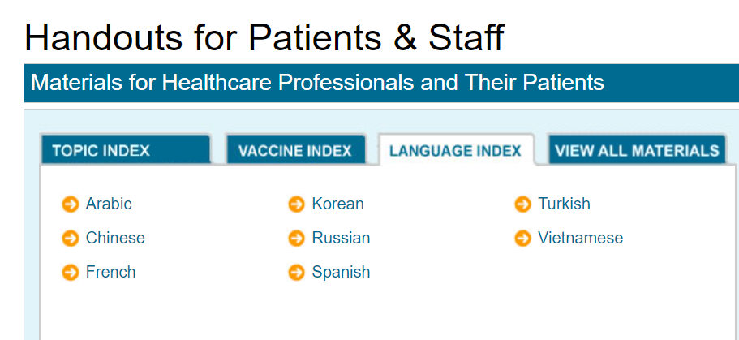

Slide 29
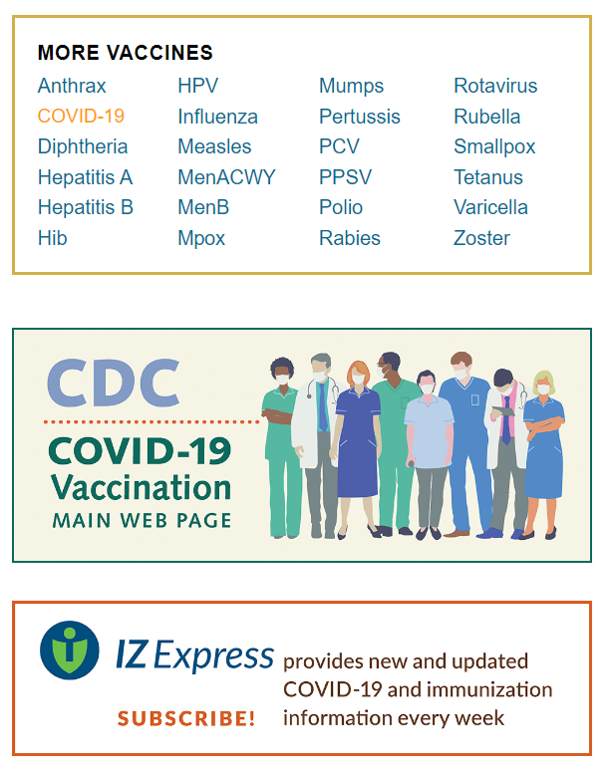

Slide 30
Source Control
Suspected or confirmed SARS-CoV-2 or other respiratory infection
Runny nose – cough- sneeze
Outbreaks and outbreak investigations
Local, state or another jurisdiction or authority
When on isolation and or caring for folks on isolation

Slide 31
Monitoring
Change in condition policy and procedure
Consider skill level and attention to detail of your staff
Outbreak or outbreak investigation

Slide 32
Q&A
MAY 22, 2019
IHCA.ORG

