Slide 1
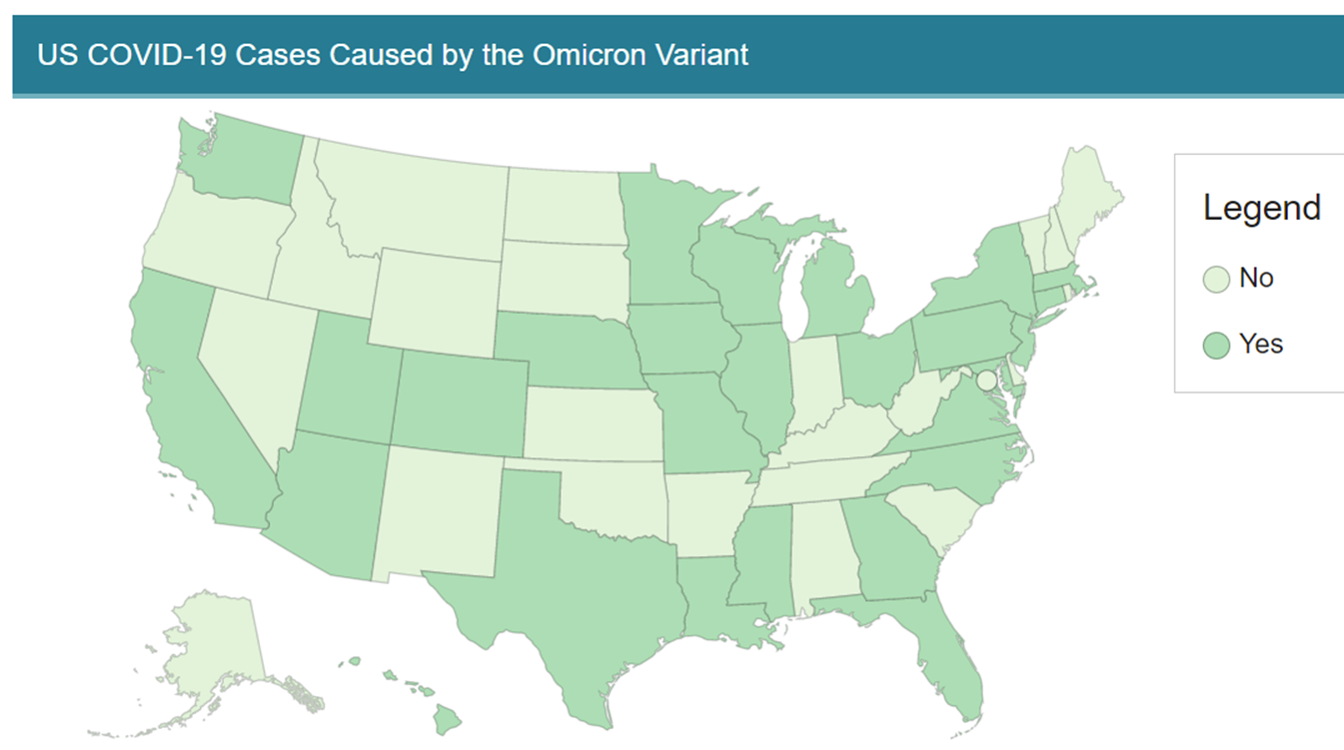
Omicron Variant Spreading Quickly
First case Nov 9th in S. Africa
Now in 60 countries
43 cases in US
2/3rd acquired in US
Waste-water tests
North, Central & Southern CA
Boulder CO
As of Dec 10th 2021 per CDC website:
https://www.cdc.gov/coronavirus/2019-ncov/variants/omicron-variant.html

Slide 2
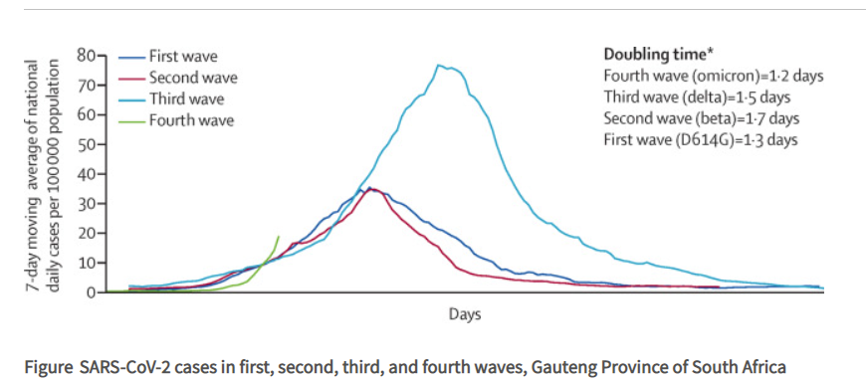
Omicron More Infectious Delta Variant
UK study of infection spread in households
Omicron 3.2x more likely to spread to household contacts vs Delta
In South Africa Omicron
Cases are doubling every 2-3 days which is faster than Delta surge
Lancet 398 (10317):p2126-2128 Published:December 03, 2021DOI:https://doi.org/10.1016/S0140-6736(21)02758-6

Slide 3
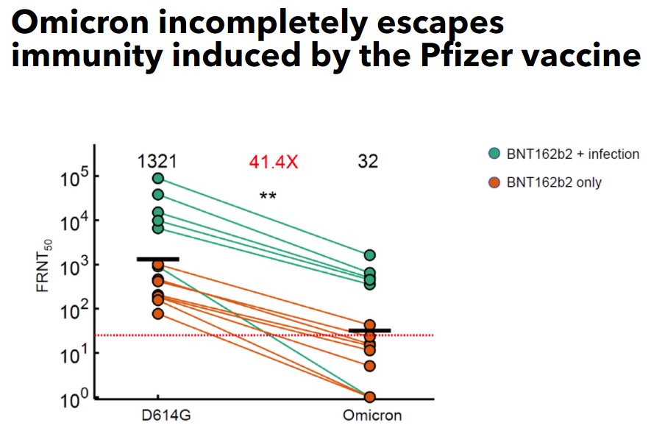
Do the Vaccines work against Omicron?
UK study by Oxford university¹ found mRNA vaccines
2 doses 34% effectiveness
2 doses + booster 74% effectiveness
Preliminary study by Pfizer found booster increased neutralizing antibodies in lab cells infected by Omicron by 25 fold²
South Africa looking at antibodies blocking infection in laboratory cells shows booster and prior infection better than just fully vaccinated³
¹ Reduced Neutralization of SAR-COV-s Omicron B.1.529 variant by post-immunization serum. Published on line Dec 13th 2021 doi: https://doi.org/10.1101/2021.12.10.21267534
² Pfizer and Biontech provide update on omicron variant. Released Dec 8th 2021 Pfizer press release
³African Health Research Institute Published online Dec7th 2021 at: https://www.ahri.org/omicron-incompletely-escapes-immunity-induced-by-the-pfizer-vaccine/

