Slide 1
Operationalizing CMS’s Infection Control Protocol
March 26, 2020
Presented by:
Lori Davenport, RN
Director of Regulatory & Clinical Affairs
MAY 22, 2019

Slide 2
OVERVIEW
CMS Focused Survey Infection Control Protocol
Achieve understanding of the new Focused Survey Protocol from CMS, providing guidance on Infection Prevention and Control Practices
Obtain recommendations on operationalizing the Focused Survey Protocol in your daily operations.
Resources to help organize to navigate an Infection Control Focused Survey

Slide 3
Lessons Learned from Kirkland, Washington

Slide 4
Kirkland Survey Findings
Failure to rapidly identify and manage ill resident
Failure to notify the health department of the increasing rate of respiratory infections among residents.
Failure to possess a backup plan following the absence of the facility’s primary clinician, who fell ill.
IJ Level S/S

Slide 5
Infection Control Overview F880
The facility must establish and maintain an infection control program designed to provide a safe, sanitary and comfortable environment and help prevent the development and transmission of communicable disease and infection.

Slide 6
Infection Control Overview F880
The facility must establish and maintain a system for preventing and identifying, reporting, investigating and controlling infections and communicable diseases for all residents, staff, volunteers, visitors, and other individuals providing services under contract arrangement based upon the facility assessment conducted according to 483.70. following accepted national standards.

Slide 7
Infection Control Overview F880
The facility must develop and implement policy and procedures that, at a minimum:
Explains how standard precaution and when and where transmission-based precautions should be utilized.
Prohibits staff with a communicable disease from direct contact with resident or their food.
Requires staff to follow hand hygiene consistent with acceptable standards.
Handles, stores, processes, transports all linens and laundry with acceptable standards.

Slide 8
Results from Kirkland
CMS and CDC collaboration on focused survey process
Incorporates elements of CDC Preparedness Checklist
Expectation of facility self-assessment with the new protocol
If onsite investigation occurs the self-assessment documents may be requested
CMS encourages sharing of the self-assessment with state and local health departments

Slide 9
Call to Action Implement the CMS Self-Assessment Tool and Prevent the Spread of Infection

Slide 10
Survey Approaches
IJ Investigations
Related to Facility Reported Incidents and Complaints
Focused survey protocol will be used
Targeted Infection Control Surveys
Providers identified though CDC and HHS coordination
Focused survey protocol will be used
CMS expects providers to self-assess Infection Control plans and protections

Slide 11
Tools to Help
CDC Coronavirus Disease 2019 COVID-19 Preparedness Checklist for Nursing Homes
CMS COVID-19 Focused Survey for Nursing Homes

Slide 12
CDC Coronavirus Disease Checklist
Rapid identification and management of ill residents
Considerations for visitors and staff
Supplies and resources
Sick leave policies and other occupational health considerations
Education and training
Surge capacity for staff equipment and supplies and postmortem care
Contact numbers of key individuals and organizations

Slide 13
CDC Coronavirus Disease Checklist
You will be asked about item 3 on the CDC Checklist
The checklist will assist you with knowing what you need to include for the Elements of a COVID 19 Plan
If you don’t have something you need, reach out

Slide 14
CMS COVID-19 Focused Survey
These concerns have already been identified:
Enter a building with a PUI or active case and no staff are wearing masks
Improper use of ABHR when placing in a pocket
Not thinking through the contamination of hands when leaving room
Inconsistent screening at the entrance
Not knowing who is in charge
Staff not knowing if the cleaning products are effective for coronavirus
Using multiple entrances

Slide 15
CMS COVID-19 Focused Survey General Standard Precautions – Observations
Respiratory Hygiene/cough etiquette
Post Signs and Educate upon entering for shift
See it Say it and don’t forget resident education on this one
Environmental cleaning and disinfection
Use as approved and per instructions – be conversant on this
Reprocessing of reusable resident medical equipment

Slide 16
CMS COVID-19 Focused Survey Hand Hygiene
Are staff performing hand hygiene when indicated?
Before shift starts / after shift ends and everything in between
Keep ABHR out of the pockets and use it properly – Education!
Resident hand washing after toileting and before meals
How are you ensuring hand hygiene supplies are readily available and who to contact for replacement supplies?
Start of shift and end of shift – Its everyone’s business to check and inform.
Hand hygiene even with use of gloves – before and after

Slide 17
CMS COVID-19 Focused Survey Personal Protective Equipment
Emphasis on gloves – potential contact with blood or bodily fluids, mucous membranes (meal assistance), or non-intact skin.
Gloves are changed and hand hygiene is performed before moving from a contaminated body site to a clean one. – decrease infections
Gown is used when there are uncontained secretions or excretions
PPE removed and discarded after resident care – prior to leaving room – May change with extended use – national and local shortages but hand hygiene must be done.
Note: if extended/reuse of gowns – follow national guidelines to clean after and between uses
Note: No official guidance for reuse of surgical face masks – TBD

Slide 18
CMS COVID-19 Focused Survey Personal Protective Equipment
Shortages of PPE
Document, document, document
CMS expects when shortage occurs:
Contact Local Healthcare Coalition – Indiana Contacts Link
Follow guidelines on optimizing current supply and prioritize use based on procedures that increase risk to infectious organisms
Healthcare professionals guidance link
Healthcare facilities guidance link
PPE Optimization guidance link
These are what you will need to show surveyors when you don’t have PPE to demonstrate “compliance”

Slide 19
CMS COVID-19 Focused Survey Transmission-Based Precautions
Contact Precautions
Gloves and gown before contact with person or environment
Droplet Precautions
Face mask within 6 feet of a person
Airborne Precautions
Most nursing homes cannot do this

Slide 20
CMS COVID-19 Focused Survey Unknown Diagnosed Respiratory Infection
Known or suspected COVID -19 – gloves, gown, mask and eye protection/shields
Cohorting to save PPE and decrease number of staff contact with residents
Think dirty and clean
Symptoms
Signage – communication – huddles
Dedicated / Disposable equipment – disinfecting properly is the key

Slide 21
CMS COVID-19 Focused Survey Unknown Diagnosed Respiratory Infection
Do staff understand how residents are placed into Transmission-Based Precautions and how staff is monitored for compliance?
Aerosol-generating procedures (AGPs) – Switch treatments if possible, to mitigate risk
Housekeeping – Think clean and dirty – EPA Registered disinfectant
How do you categorize staff wearing PPE when supplies are low?
Not the department it is the level of contact with residents

Slide 22
CMS COVID-19 Focused Survey Resident Care
When sustained community transmission or case(s) of COVID 19 inside the facility:
Restrict (to the extent possible) in resident room – except when medically necessary
Resident leaving the room with an active case of COVID to wear mask and limit movement, good hand hygiene and practice physical distancing – (efforts to keep 6 feet away from others)

Slide 23
CMS COVID-19 Focused Survey Resident Care
When sustained community transmission or case(s) of COVID 19 inside the facility:
Conserve masks if there is a shortage – limit to resident diagnosed with or having active symptoms associated with a respiratory infection or COVID-19
No group outings, gatherings, or communal dining – document it
Are you conducting surveillance of residents by monitoring and communicating symptoms and acting on that with appropriate precautions and PPE and cohorting? Private room, double room with door and curtain closed?
Transfers take coordination between all parties – to outside medically necessary appointments and to higher levels of care.

Slide 24
CMS COVID-19 Focused Survey Infection Control Standards, Policies and Procedures
Refer to the CDC Checklist
Cross reference with your facility’s Infection Control Program policy & procedure
Do your P&P use national standards for undiagnosed respiratory illness and COVID-19? Add as needed.
Policy or procedures include when to notify local/state public health officials if there are clusters of respiratory illness or cases of COVID 19 that are identified or suspected?

Slide 25
CMS COVID-19 Focused Survey Infection Surveillance – Screening Resident and Staff
Visitors – Make sure you have signage on the door
Tracking – Monitoring – Reporting
No less than daily for residents
Prior to shift – Active Screening!
More than a task but requires oversight – do something with what you know
What is a fever?
Respiratory signs/symptoms or other symptoms related to COVID 19

Slide 26
CMS COVID-19 Focused Survey Infection Surveillance – Screening Resident and Staff
How many staff and residents diagnosed with COVID 19?
How many residents and staff have been tested – Protocol for testing?
Solid transfer process that is informative – Give them what you would want to know
Decision tree for staff – Nursing and unit managers for communicating and elevating information with local and state public officials – succession plan = more is better

Slide 27
CMS COVID-19 Focused Survey Infection Surveillance – Screening Resident and Staff
Screen all employees at the door actively and any contractual individuals
Record data
When screening vendors – Change the Question
Have you had exposure to PUI/COVID 19 positive without PPE?
Know restriction criteria – and follow it without hesitation
What instructions are given during entrance? How do you communicate this information?
How to monitor self and how and who to report symptoms as they occur. – 24/7

Slide 28
CMS COVID-19 Focused Survey Education, Monitoring, and Screening of Staff
COVID 19 documented education to staff
How to give updates to staff
Symptoms occur – face mask on and go home – report to public health and ISDH ASAP
Provide calm and reinforcing instructions to your employee
Gather information on individuals, equipment, and locations the person encountered.
Know current guidance about returning to work – Local health department can advise

Slide 29
CMS COVID-19 Focused Survey Staffing Emergencies – Emergency Preparedness
Plan on how to ensure staffing to meet the needs of the residents
Regularly check availability of PRN staff
Check your local retirees – still have an active license?
Document contact with staffing agencies and be ready to activate
Contact local hospitals to ask for help in a surge
Explore use of ISDH waivers – PCA and dining assistant
Telehealth options?
Combat Pay for COVID Care
Child Care Partnerships
Are volunteers allowed?
How do you implement the plan?

Slide 30
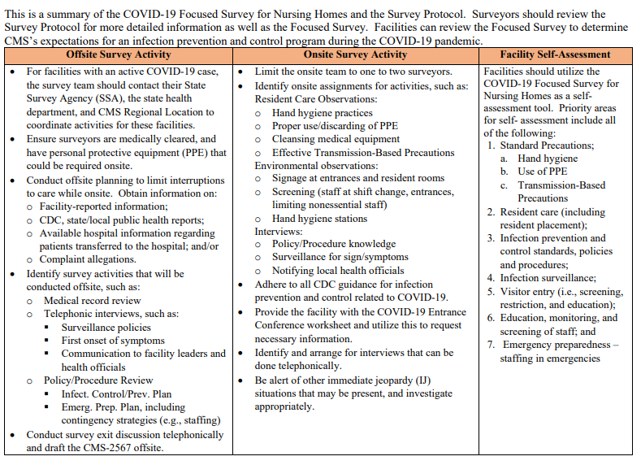

Slide 31
THANK YOU!
MAY 22, 2019
IHCA.ORG

